Slide 1


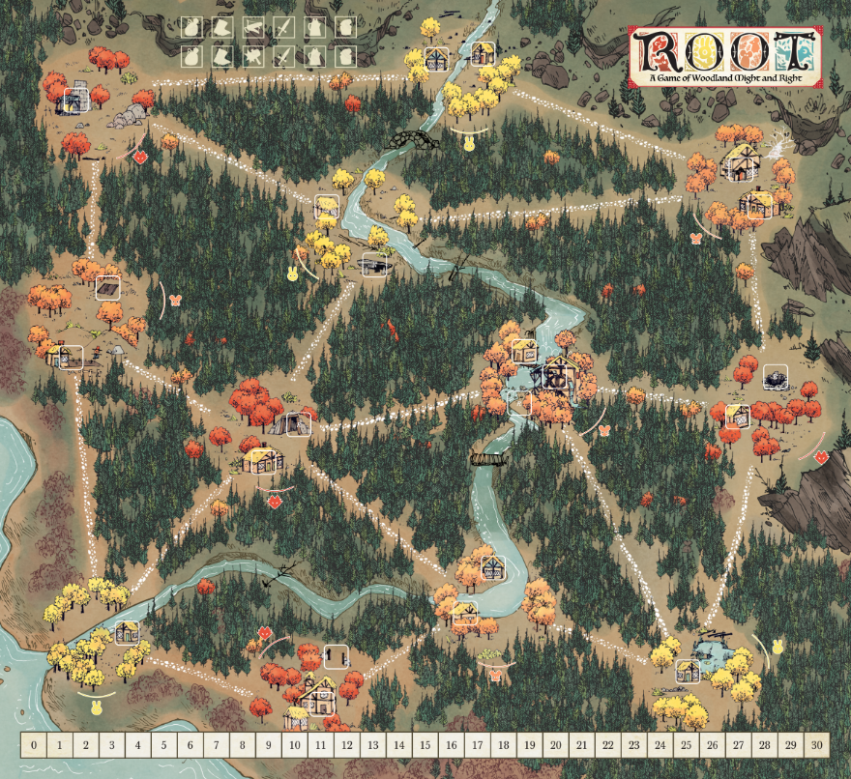


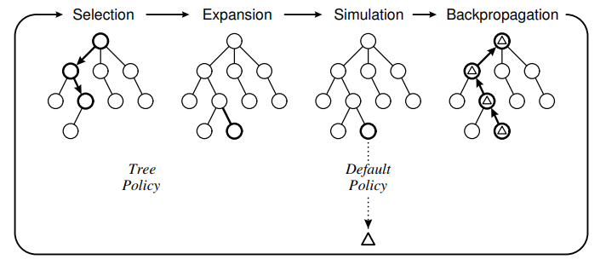

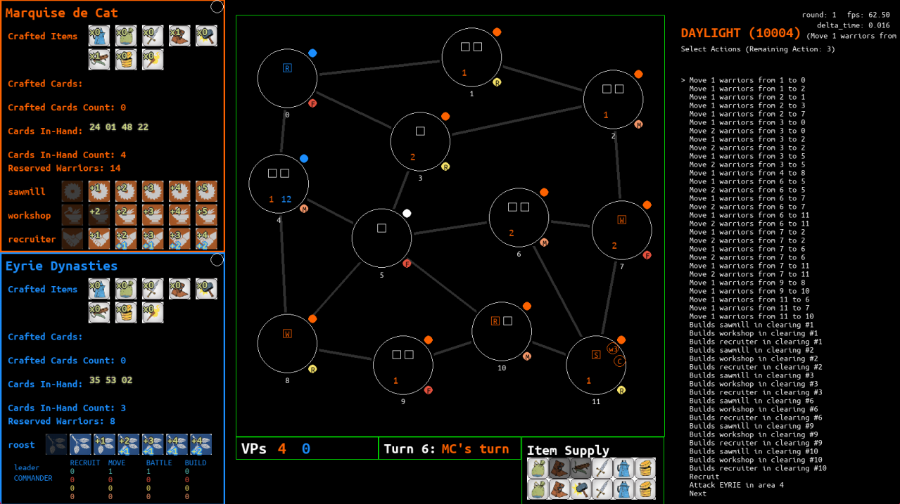




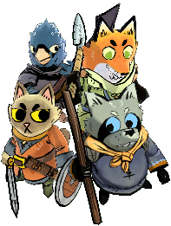
Project No. P003-2/66, Academic Year 2023
Artificial Intelligence for Root Board Game
Baangkok Vanijyananda, Pawaret Dilokwuttisit, Advisor: Kasemsit Teeyapan
Computer Engineering, Faculty of Engineering, Chiang Mai University
Introduction
A video game version of Root was released in 2020, but there are multiple reports by its players that the AIs make awful decisions that no humans would ever make in a similar situation. i.e., their AIs are bad. Especially Eyrie Dynasties’ AI.
Objectives
To create an artificial intelligence (AI) that can play the board game “Root”.
To find the best Monte Carlo Tree Search (MCTS) algorithm variant for playing the board game “Root” for each faction.
Methods
Create a minimal version of Root video game.
Implement the Open-Loop MCTS algorithm.
Create 108 MCTS variants for each faction
and have them fight against the other faction with the base MCTS variant → total 216 battles, 216000 rounds of simulation.
Top 5 variants with highest win rate for each faction face a “Team-Round Robin” fight, i.e., they all fight each other.
The variant from each faction with highest average win rate will be the best variant for that faction.
Results
The best MCTS variant for Marquise de Cat achieved 60% average win rate with the following parameters:
reward-function: vp-difference-relu
expand-count: 200 nodes
rollout-count: 1 rollout
time-limit: no-limit
action-count-limit: no-limit
best-action-policy: secure (maximum lower confidence bound)
The best MCTS variant for Eyrie Dynasties achieved 60% average win rate with the following parameters:
reward-function: vp-difference-relu
expand-count: 200 nodes
rollout-count: 1 rollout
time-limit: no-limit
action-count-limit: no-limit
best-action-policy: secure (maximum lower confidence bound)
Our Marquise de Cat AI achieved 60% win rate against Eyrie Dynasties AI’s 40%. Sed ornare pulvinar est, ac rhoncus sapien lacinia sit amet. Sed facilisis eros lacus, elementum mollis lacus lacinia vel. Ut quis tristique enim, non feugiat tellus. Quisque massa lectus, ultrices id justo ornare, laoreet mollis risus. Nam facilisis dolor eu malesuada efficitur. Pellentesque vel justo libero. Nam ut libero rutrum, scelerisque erat et, luctus dolor.
Conclusion
Computer Engineering, Faculty of Engineering, Chiang Mai University

